Slide 1
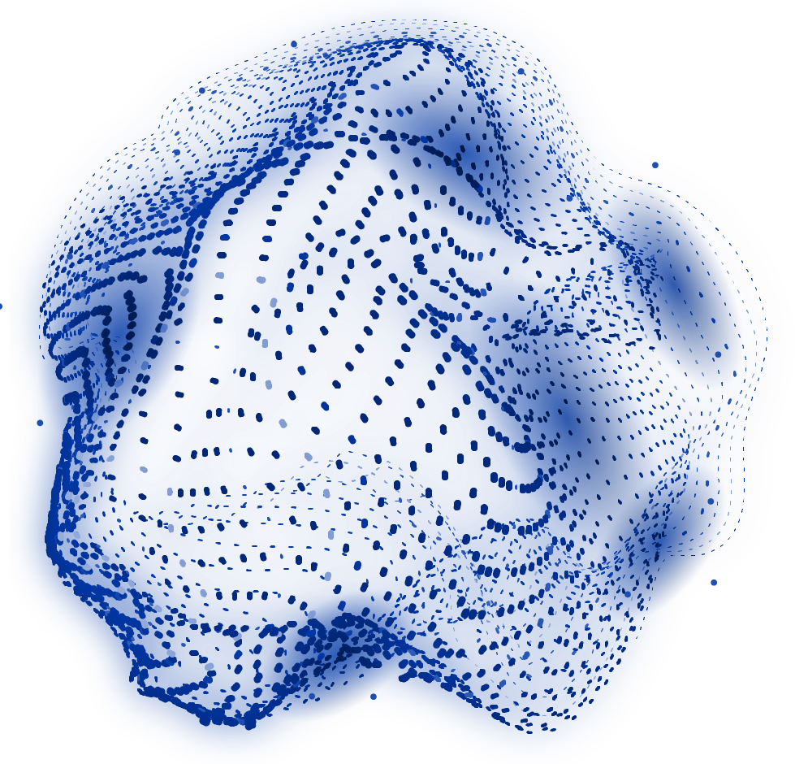
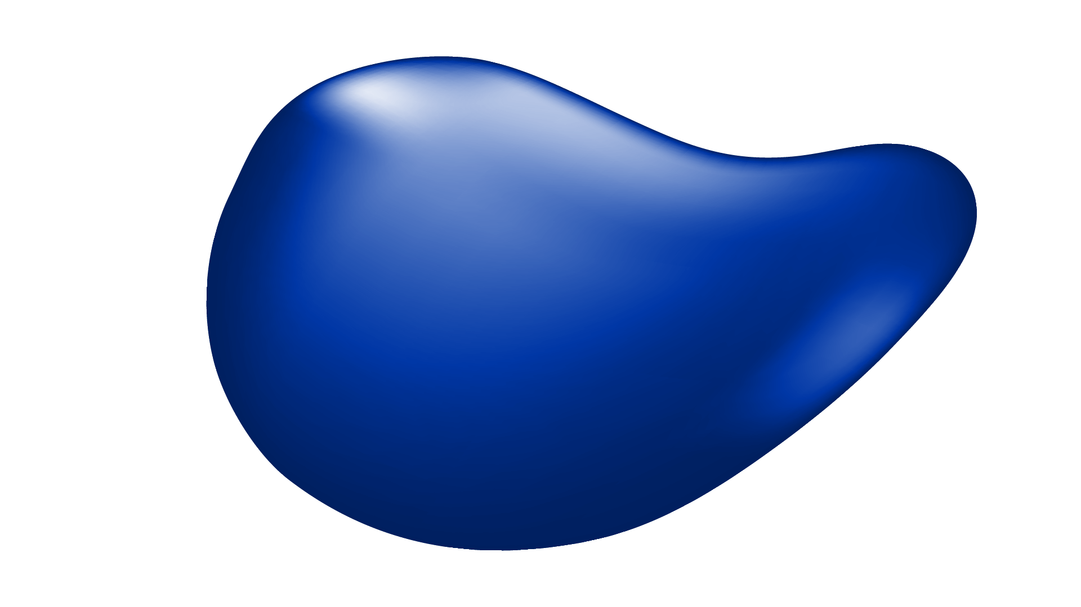

MedAssist AI
MILESTONE 1
Dharani K

Slide 2
MILESTONE 1
Objective
An AI-powered medical symptom checker that analyzes symptoms, predicts possible diseases, assesses health risk, and delivers preliminary healthcare recommendations — for patients, clinicians, and healthcare organizations.
Designed to help users understand potential health conditions early and make informed healthcare decisions.
Patients
Clinicians
Clinics & Hospitals
Telemedicine Platforms
Healthcare Organizations

Slide 3
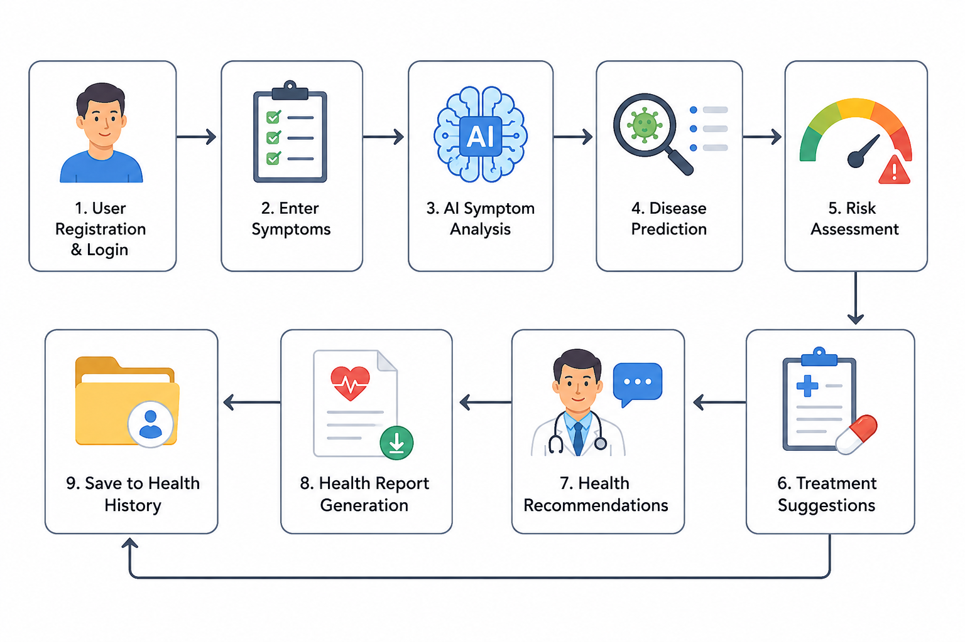
PATIENT JOURNEY
End-to-End Workflow
9 stages, from registration to saved health history

Slide 4
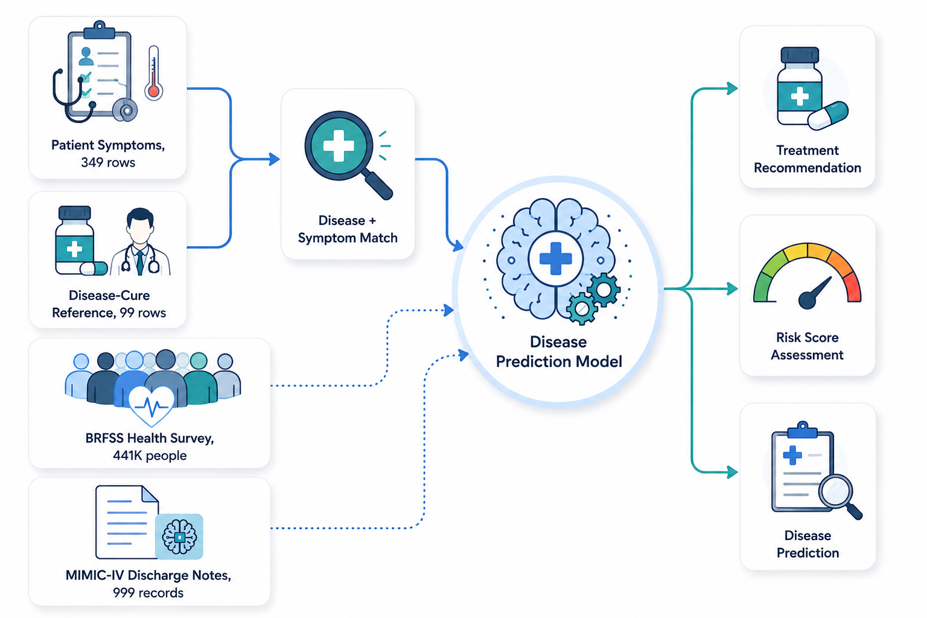
FOUR DATASETS
Dataset Pipeline
Dataset | Size | Used In
Disease Symptoms & Patient Profile | 349 rows | Symptom Analysis, Disease Prediction
Disease Prediction Using Symptoms | 99 rows | Disease Prediction, Risk Assessment
CDC BRFSS Health Survey | 441K+ resp. | Risk Assessment, Analytics
MIMIC-IV Discharge Notes (optional) | 999 records | Advanced Analytics, Research
Together, these four datasets power disease prediction, risk scoring, and treatment recommendation.

Slide 5
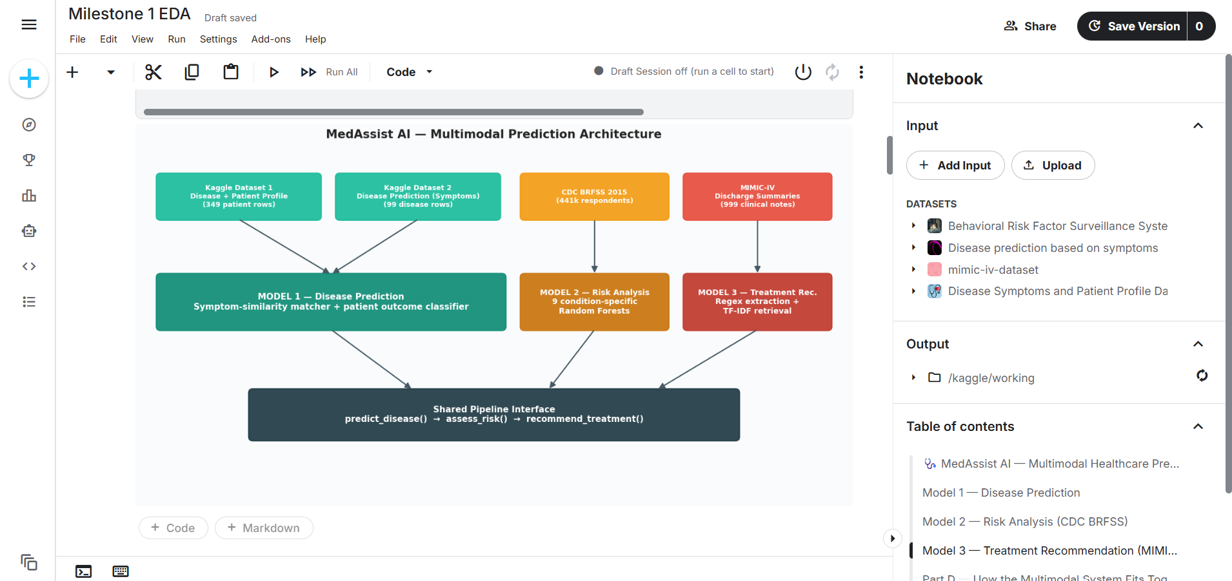
Kaggle Notebook EDA

Slide 6
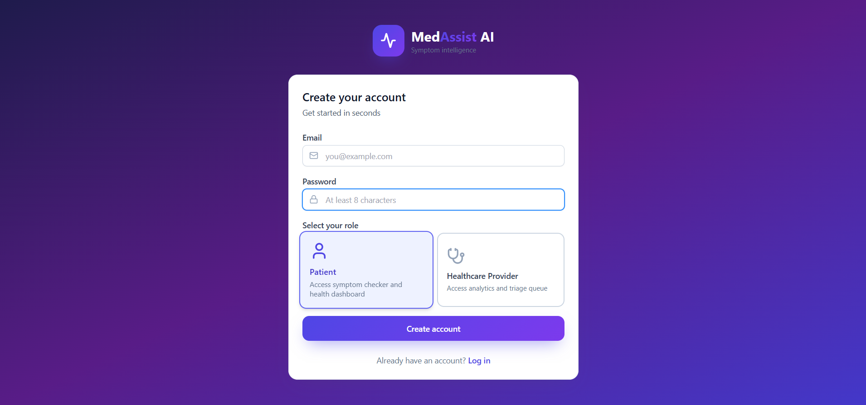
UI Wireframes - Registration and login

Slide 7
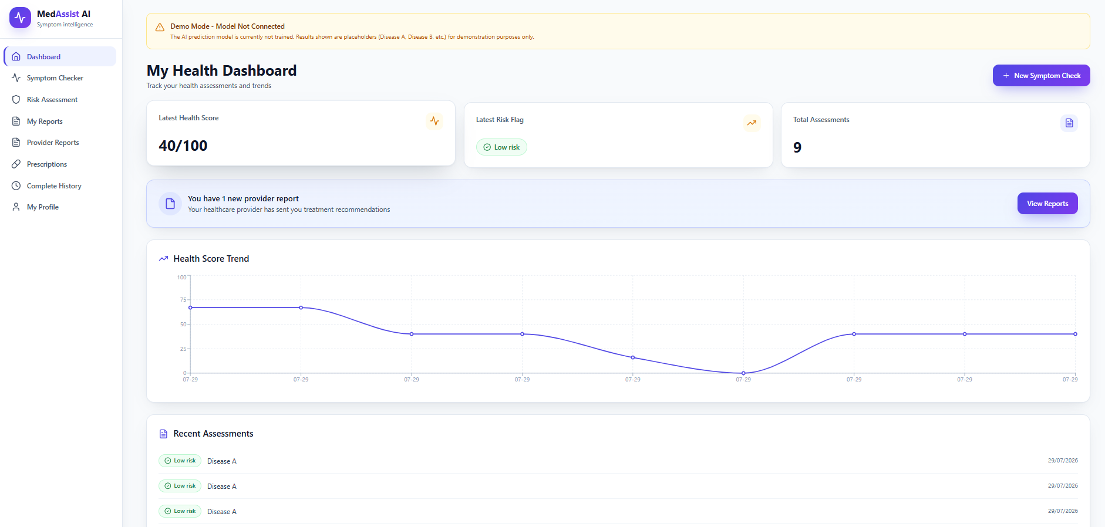
UI Wireframes - Patient Dashboard

Slide 8
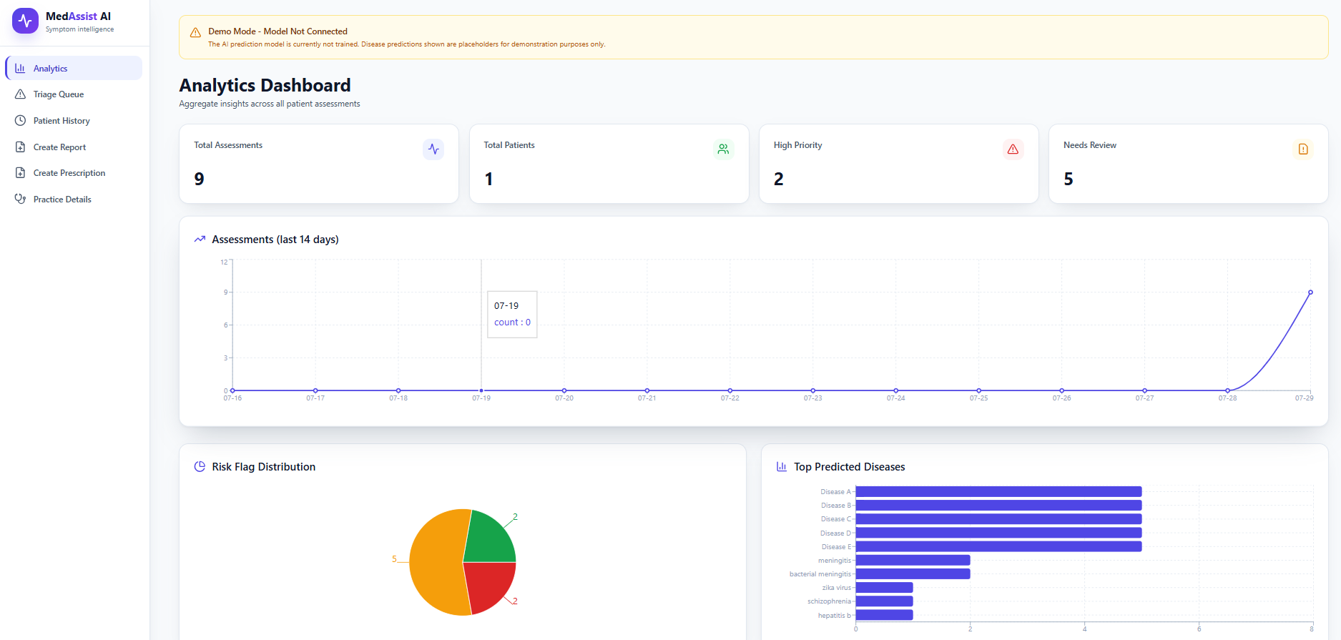
UI Wireframes - Healthcare Provider Dashboard

Slide 9
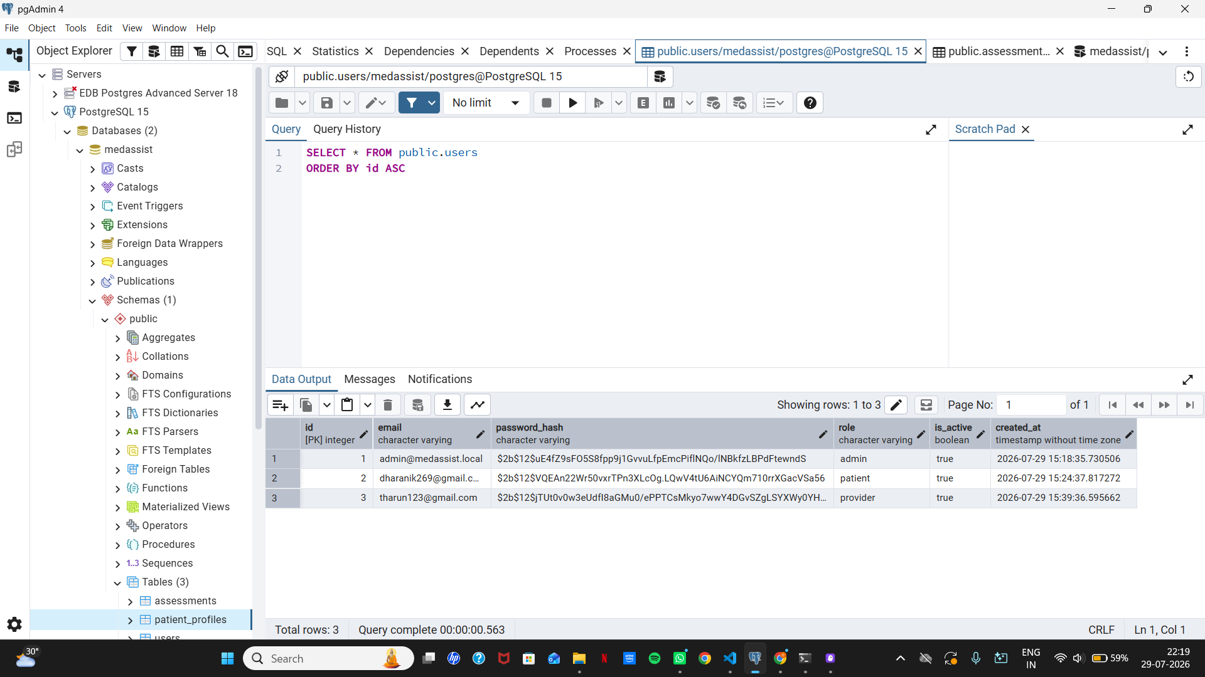
Database - PostgreSQL

Slide 10
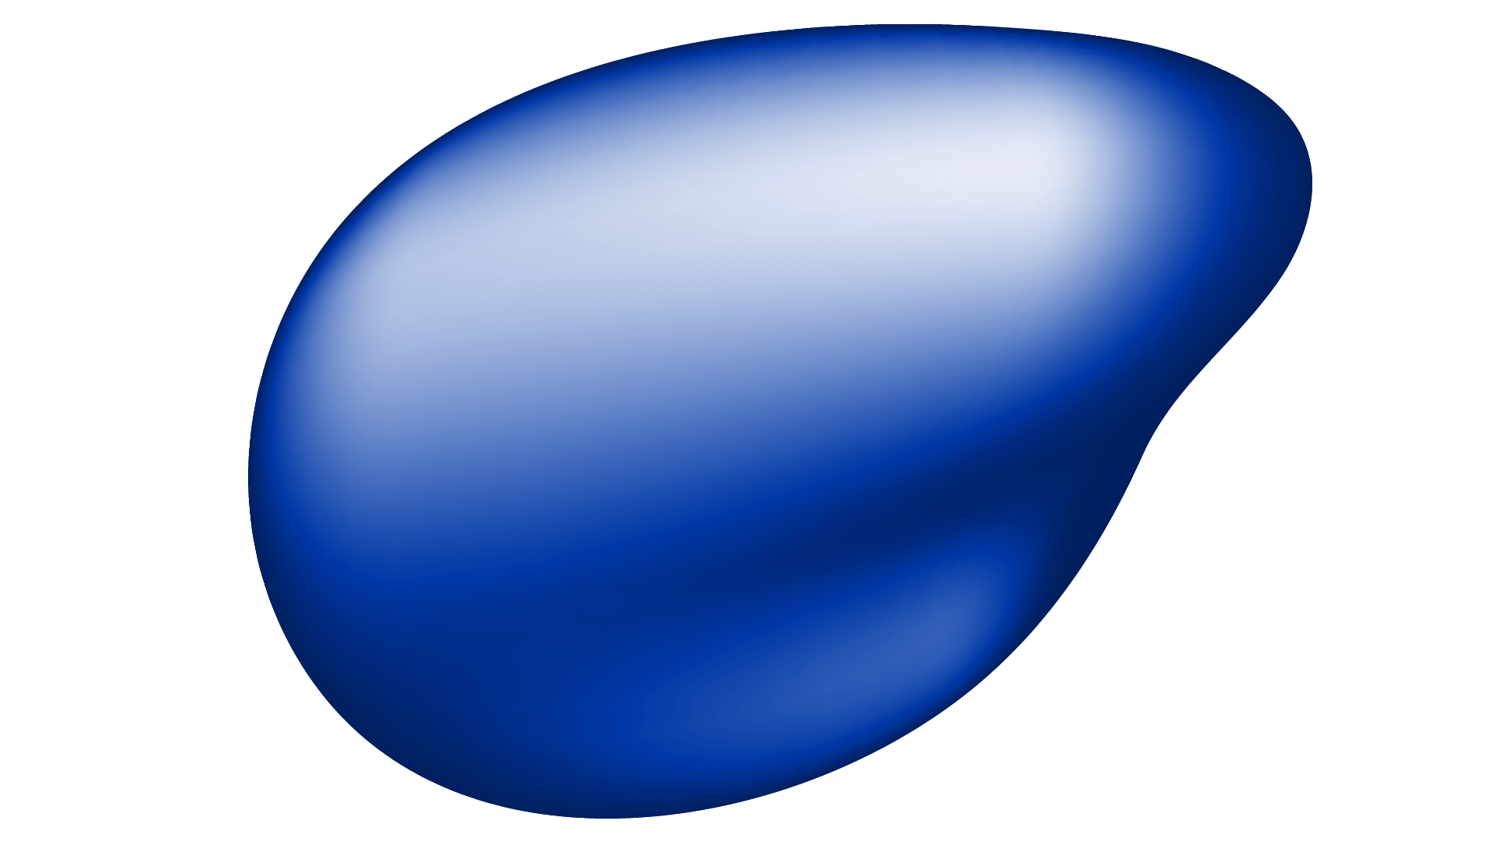
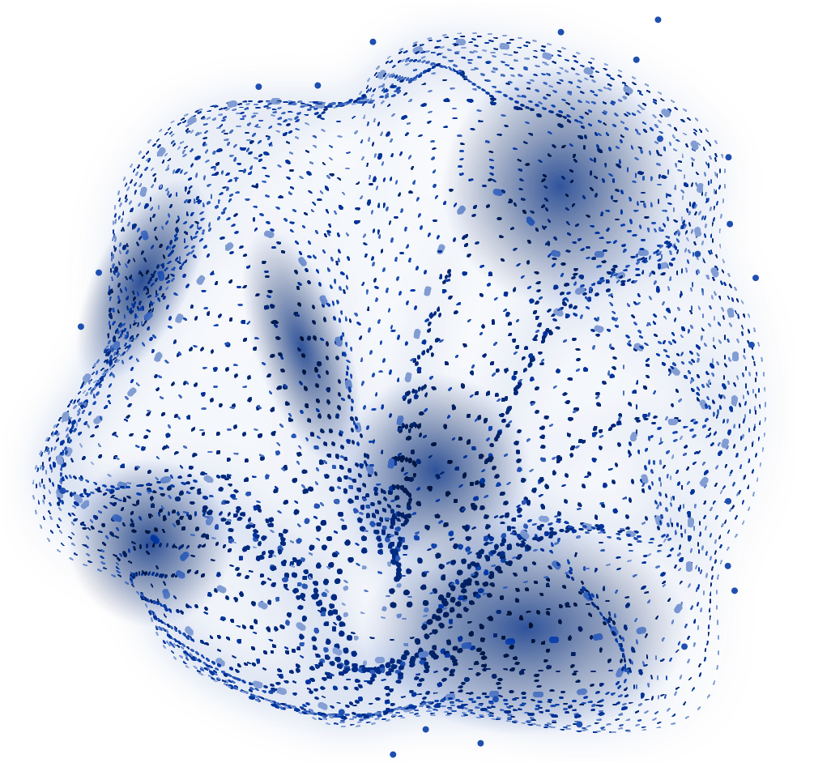
THANK
YOU!

